Slide 1
SC5010 Mini-Project : Marketing Analysis
Vilan Chan U2020092L
Glenda Lee U1911462F
Lee Rong Zhi U2040585A

Slide 2
Content
01
02
03
04
05
06
Motivation
Data Preparation
Exploratory
Data Analysis
Machine Learning Models
Summary
Conclusion

Slide 3

Motivation
Dataset used: Marketing Campaign
Find out what consumers’ attributes and/or behaviours result in a successful marketing campaign
For future campaigns
Problem:
Create a robust model to predict consumers’ response
Determine the best features that highly affect response
Suggest marketing strategies that would optimize their marketing campaign
https://www.kaggle.com/datasets/rodsaldanha/arketing-campaign

Slide 4
ID
Year Birth
Education
Marital Status
Income
Kid at home
Teen at home
Date Customer
Recency
Amount on Wines
Amount of Meat
Amount on Fish
Amount on Sweets
Amount of Gold
Amount on Fruits
Number of Deals
Number of Web Purchases
Number of Catalog Purchases
Number of Store Purchases
Number of Web Visits per Month
Accepted Campaign 2
Accepted Campaign 3
Accepted Campaign 4
Accepted Campaign 5
Accepted Campaign 1
Z Cost for Contact
Z Revenue
Response
Complain
Data Preparation
Marketing Campaign
29 Variables
2240 Observations
Consumers' Particulars
Consumers' Activities
Consumers' Purchasers
Campaign Revenue

Slide 5

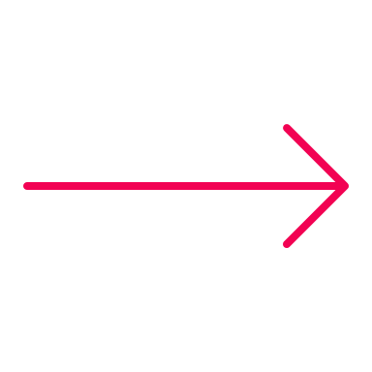
Year_Birth
Education
Marital
Kidhome
Teenhome
DtCustomer
Income
ID
Consumers’ Particulars
Year_Customer
ChildrenHome
Steps taken:
Remove ID
Replace: KidHome & Teenhome → Childrenhome
Replace DtCustomer → Year_Customer

Slide 6
Consumers’ Activities
Response
AcceptedCmp1
AcceptedCmp5
*Whether previous campaigns were accepted
. . .
Complain
Recency
Previous
Steps taken:
Replace: AcceptedCmp1, AcceptedCmp2, AcceptedCmp3 AcceptedCmp4, AcceptedCmp5 → Previous

Slide 7
Consumers’ Purchases
Amount Spent On:
Number of Web Visits
. . .
Fish
Meat
Fruits
Sweets
Wines
Gold
Number of Purchases
With discounts
With catalogue
Directly in store
Online

Slide 8
Campaign Revenue
. . .
Z_Cost Contact
Z_Revenue
Steps taken:
Remove: Z_CostContact, Z_Revenue

Slide 9
Null Values
Value Imputation
Income
24 Null Values
Consumers’ Particulars
Drop Values

Slide 10


Exploratory Data Analysis
Split the dataset into numerical variables and categorical variables
21 Variables
4 Categorical
17 Numerical
Education
Marital_ Status
Complain
Previous

Slide 11
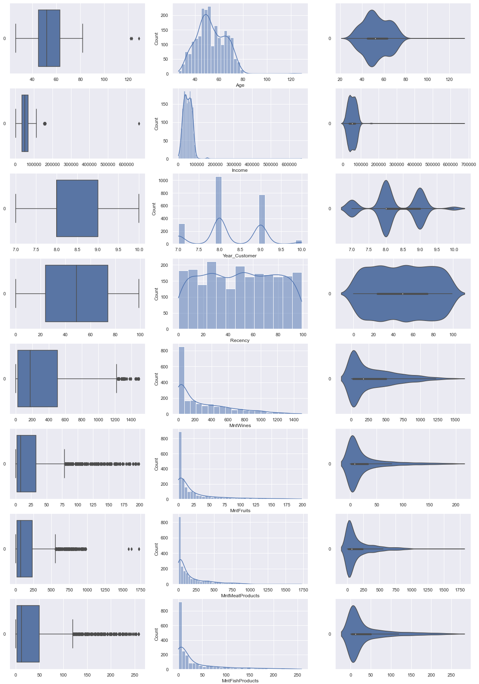
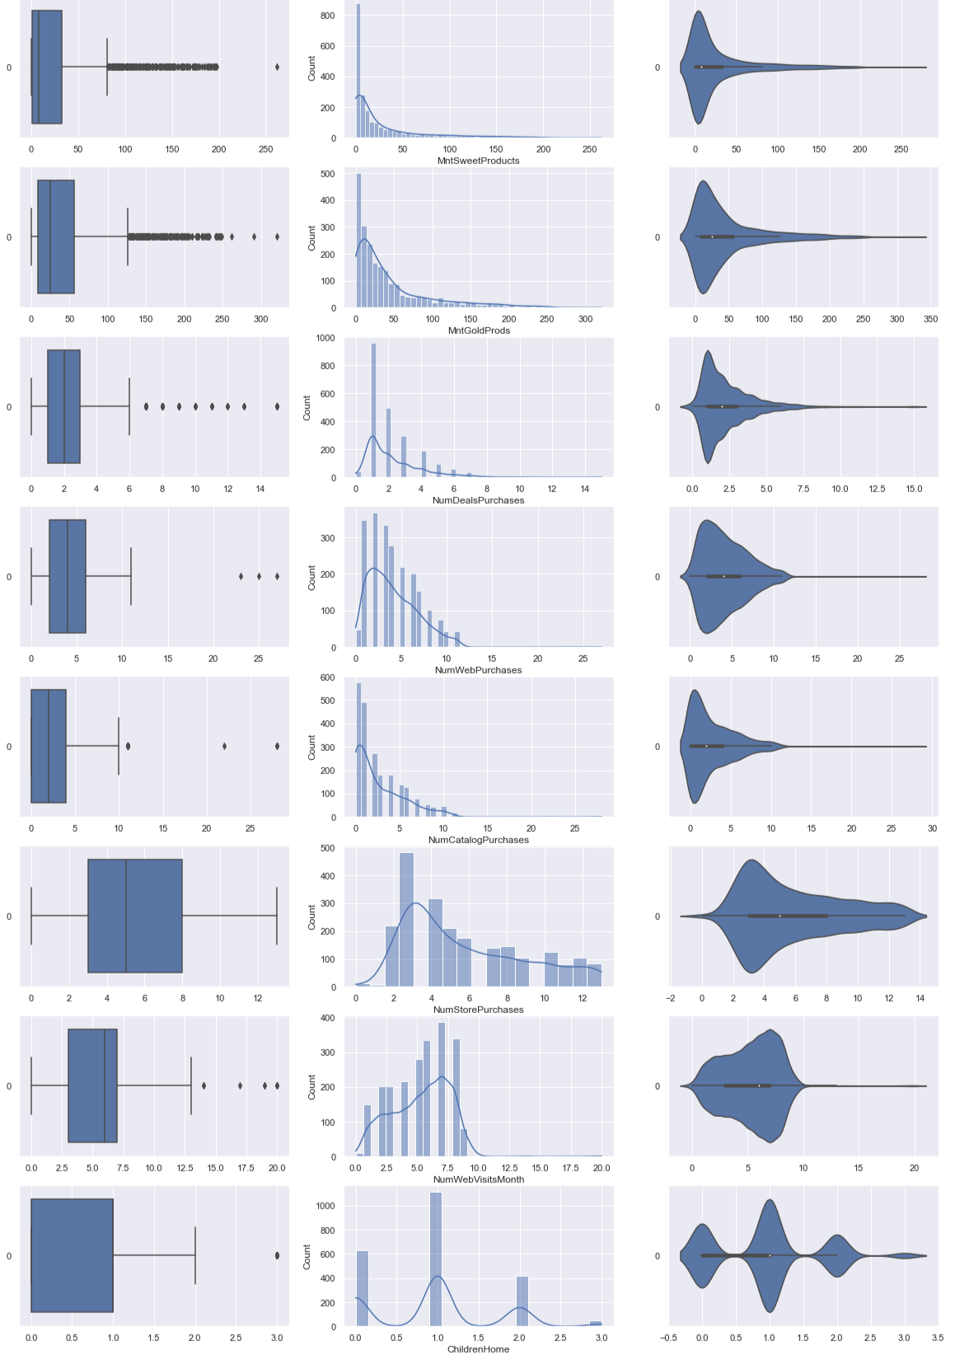
Uni-Variate Distribution for Numerical Variables

Slide 12
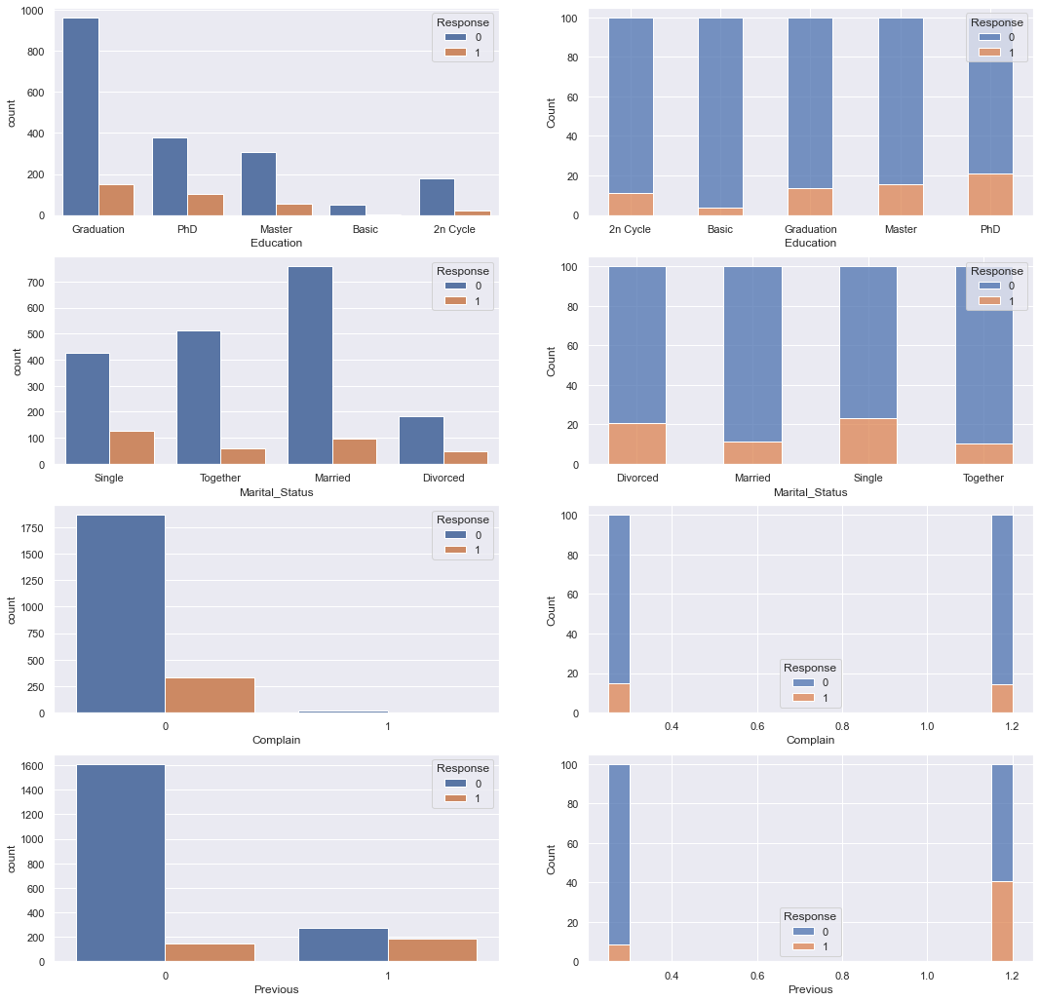
Bi-Variate Distribution for Categorical Variables

Slide 13
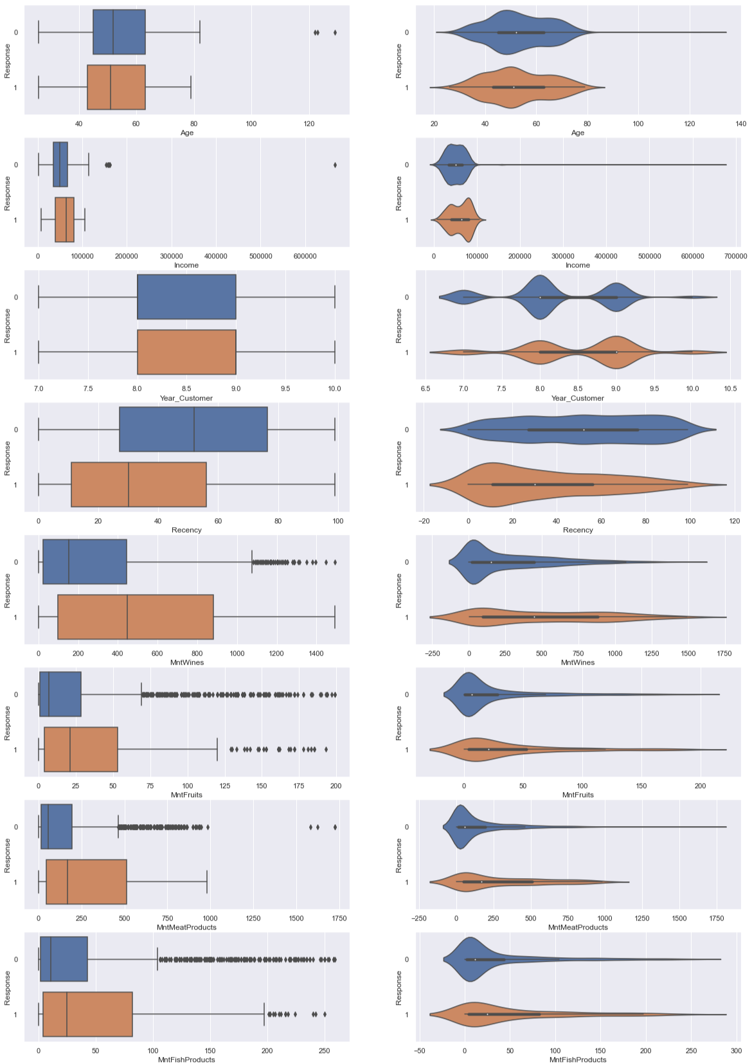
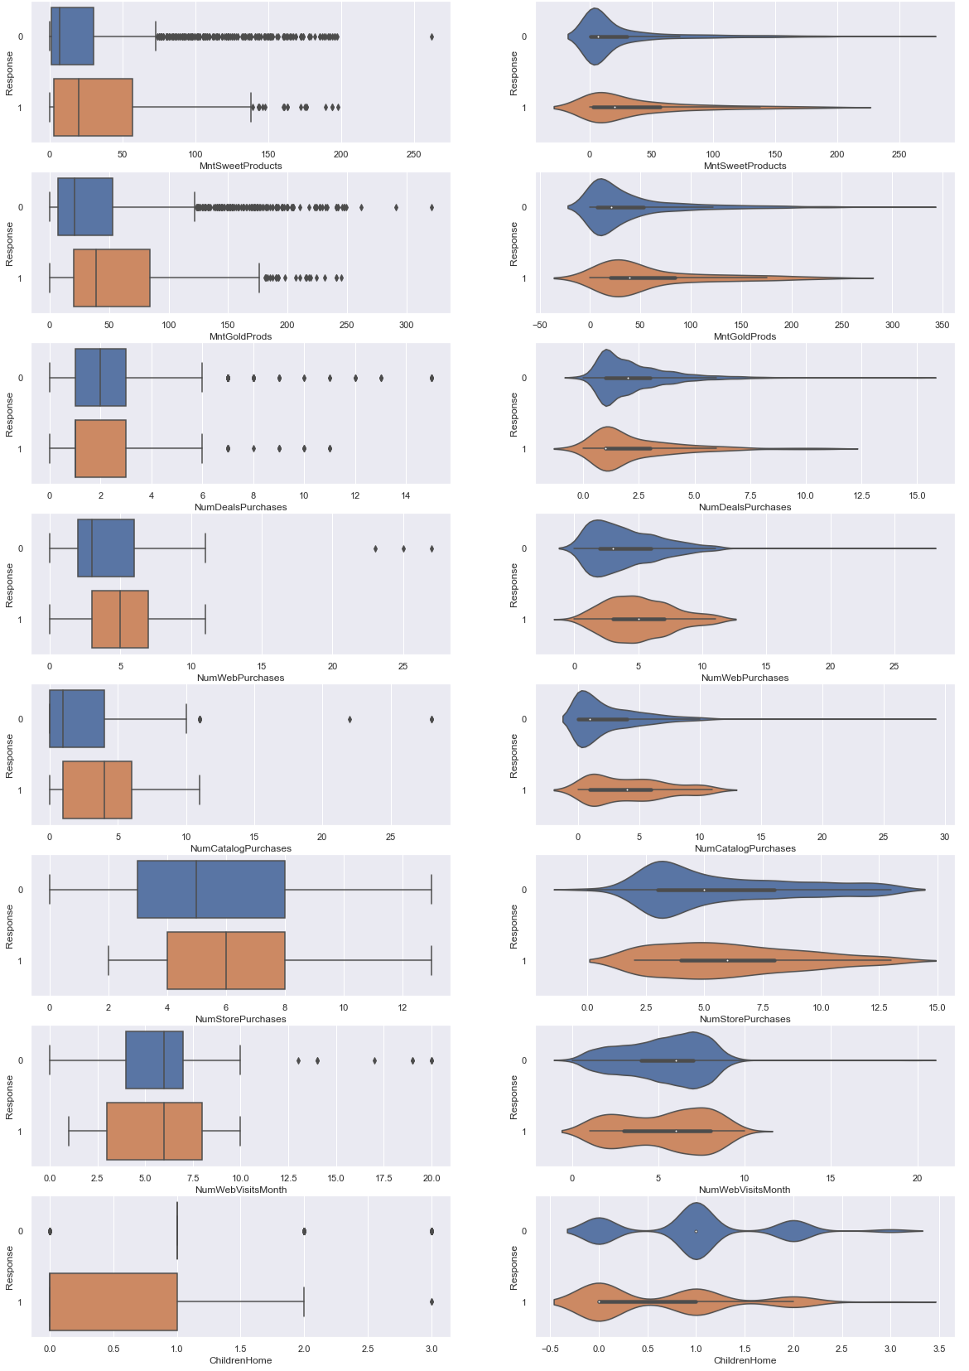
Relationship between Numerical Variables and Response

Slide 14
Machine Learning Models – Overall Flow
Pre-processing
Hyperparameter Tuning on Train Set
GridSearchCV
10 folds
Based on F1 Score
Optimized model training
Best parameters
Optimal threshold
ROC
Precision-Recall Curve
Final Evaluation
Train/Test split 80/20
Encoding – One-hot encoding
Resampling - SMOTEENN

Slide 15
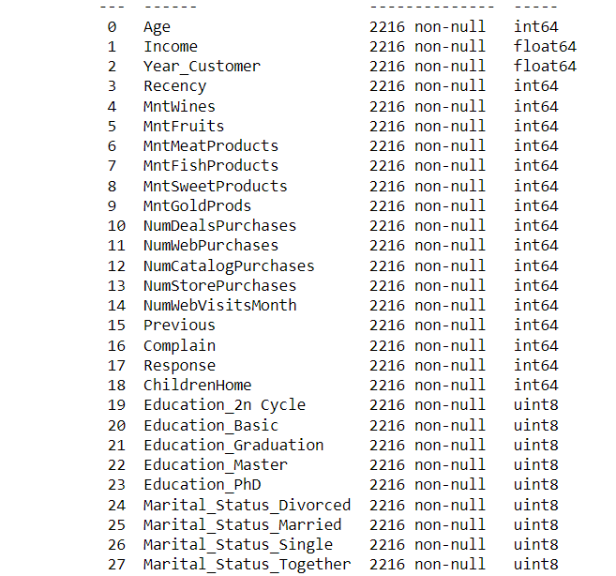
Converting Categorical Variables to Numerical Variables
Implement One Hot Encoding
Each level is now an individual column

Slide 16
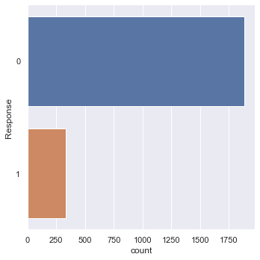


Train-Test Split
Train Response
0: | 1506
1: | 266
Train : 80%
Test : 20%
Test Response
0: | 377
1: | 67
Response
0: | 1883
1: | 333

Slide 17
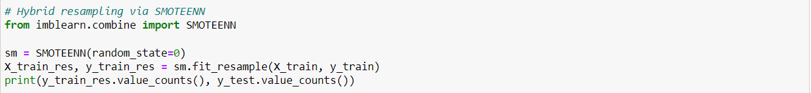
Data Resampling
Imbalance in dataset → Data Resampling needed (SMOTEENN)
Minimize effect on machine learning models
Train Response
0: | 1506
1: | 266
Train Response
0: | 1038
1: | 775
SMOTEENN

Slide 18
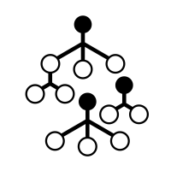
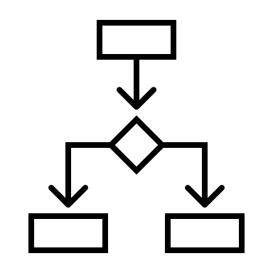

Machine Learning Models
Decision Tree Classifier
Random Forest Classifier
XGBoost

Slide 19
Multi-Variate Decision Tree
Uses the tree representation
leaf nodes corresponds to a class label
attributes are represented on the internal node

Slide 20
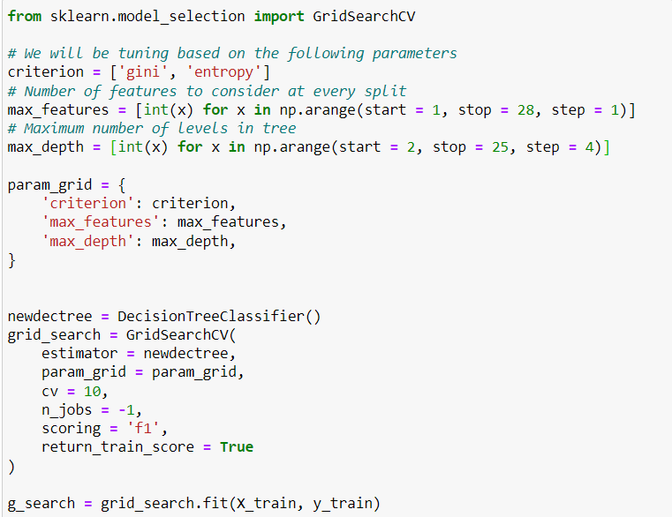
Multi-Variate Decision Tree – Hyperparameter Tuning
'criterion': 'gini',
'max_depth': 7,
'max_features': 18
Best parameters are :

Slide 21
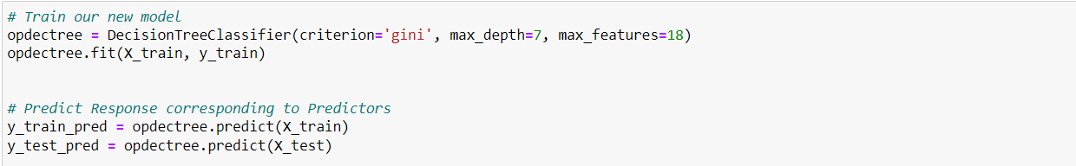
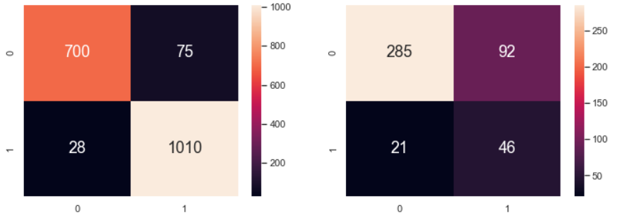
Multi Variate Decision Tree
Accuracy Score: 73.50%

Slide 22
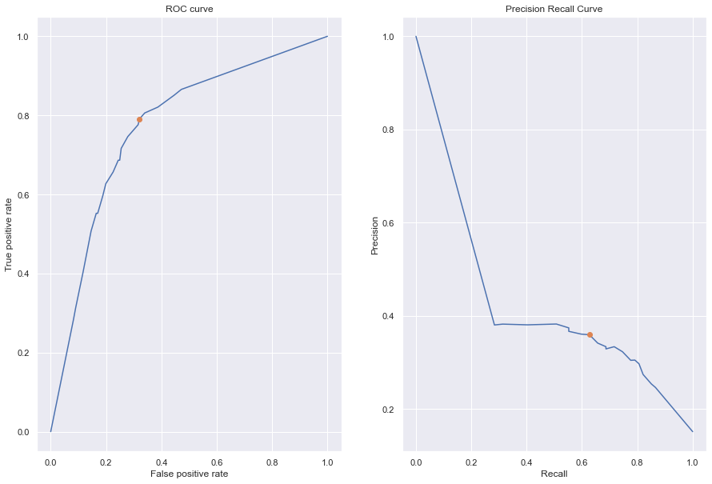
Multi-Variate Decision Tree - ROC curve & Precision Recall Curve
AUC : 0.7711
PR = 0.4

Slide 23
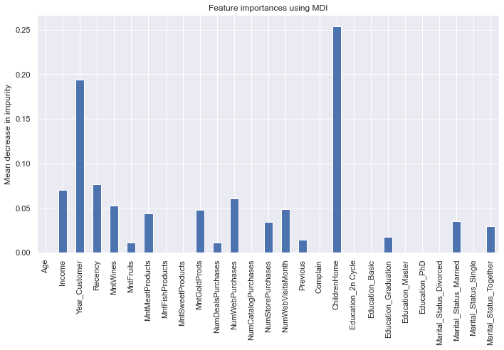
Multi-Variate Decision Tree - Features Importance
Top 4 Features
ChildrenHome
Year_Customer
Recency
Income

Slide 24
Random Forest Classifier
Ensemble of large number of individual trees
Each tree in the forest provides a type of prediction ,
Class with the most occurrences becomes the model prediction

Slide 25
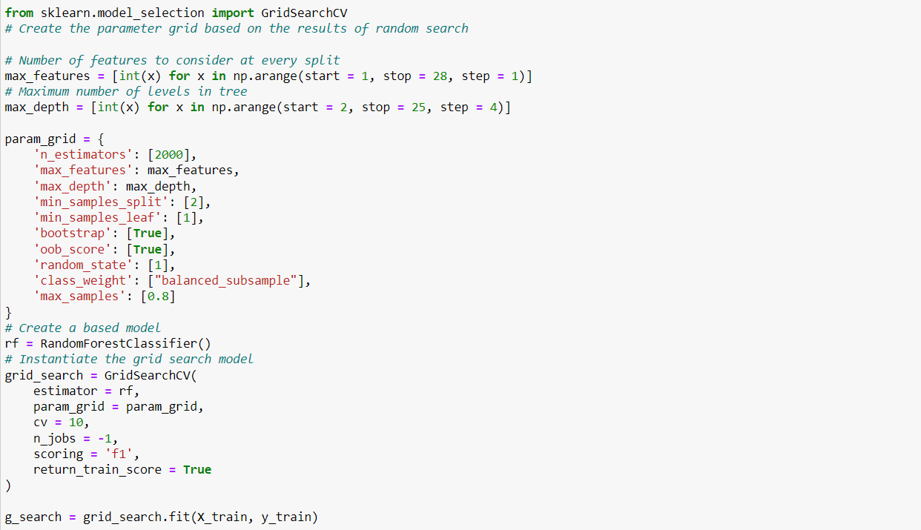
Random Forest Classifier – Hyperparameter Tuning
'bootstrap': True, 'class_weight': 'balanced_subsample', 'max_depth': 14, 'max_features': 5, 'max_samples': 0.8,
'min_samples_leaf': 1, 'min_samples_split': 2, 'n_estimators': 2000, 'oob_score': True, 'random_state': 1
Best parameters are :

Slide 26
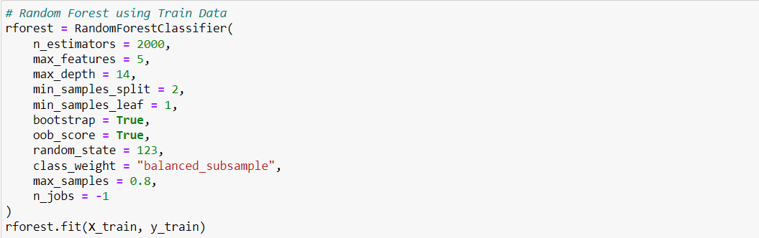
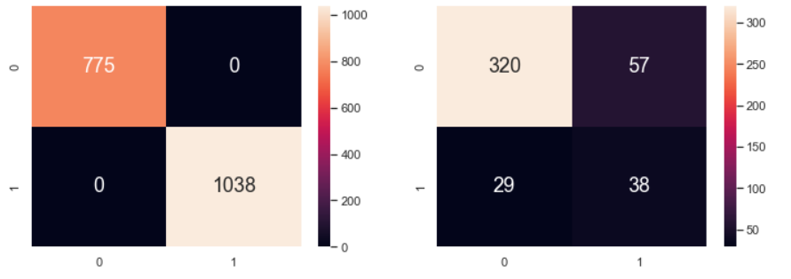
Random Forest Classifier
Accuracy Score: 76.66%

Slide 27
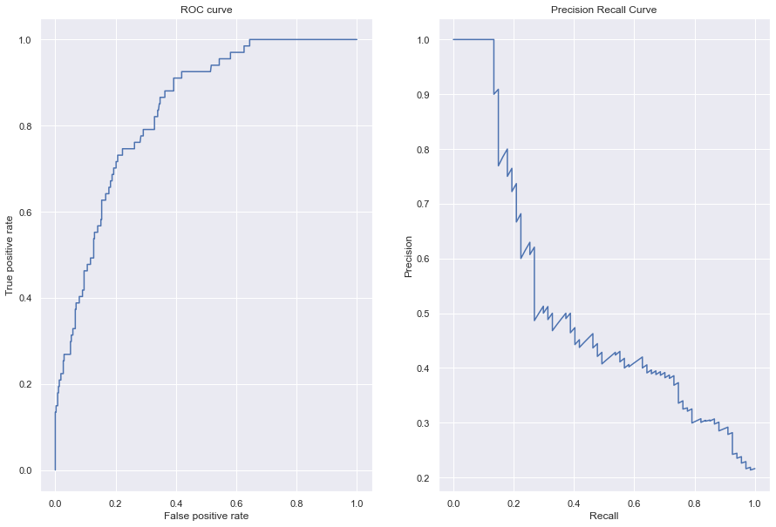
Random Forest Classifier - ROC curve & Precision Recall Curve
AUC : 0.8265
PR = 0.5

Slide 28
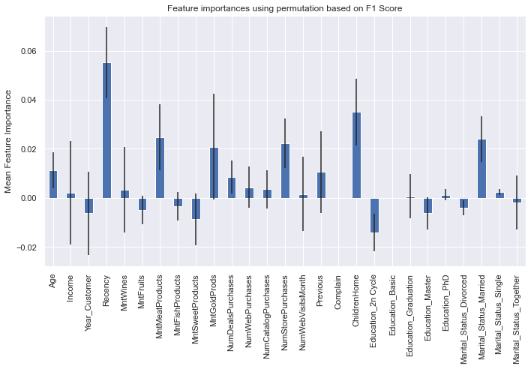
Random Forest Classifier - Features Importance
Top 4 Features
ChildrenHome
Marital_Status
Recency
MntMeatProducts

Slide 29
Extreme Gradient Boosting Classifier (XGB)
Ensemble of decision trees that uses a gradient boosting framework
Improves on the gradient boosting framework:
Use systems optimization and algorithmic enhancements
produce an accurate model of the relationship between the dependent variable and the independent variables

Slide 30
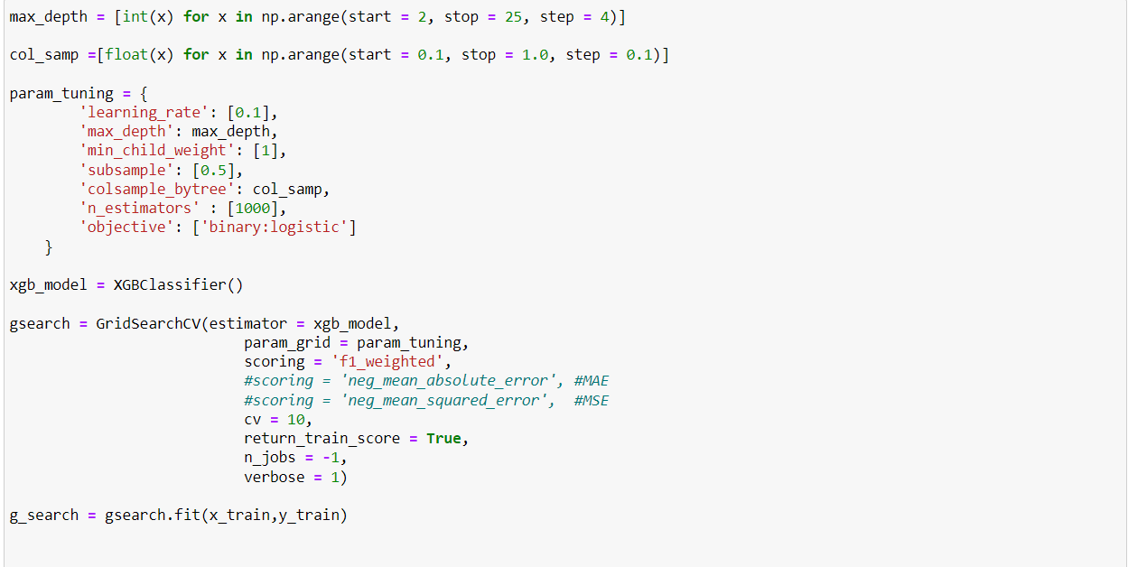
Extreme Gradient Boosting Classifier (XGB) – Hyperparameter Tuning
'colsample_bytree': 0.30000000000000004, 'learning_rate': 0.1, 'max_depth': 6, 'min_child_weight’: 1
'n_estimators': 1000,​ 'objective': 'binary:logistic',​ 'subsample': 0.5
Best parameters are :

Slide 31
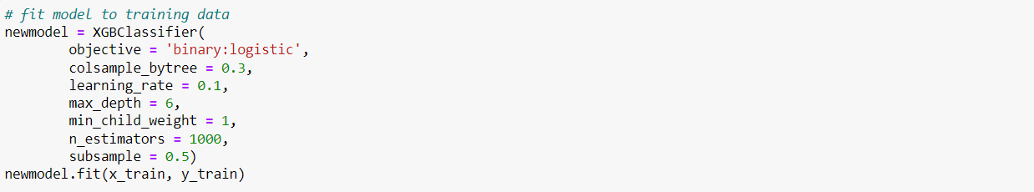
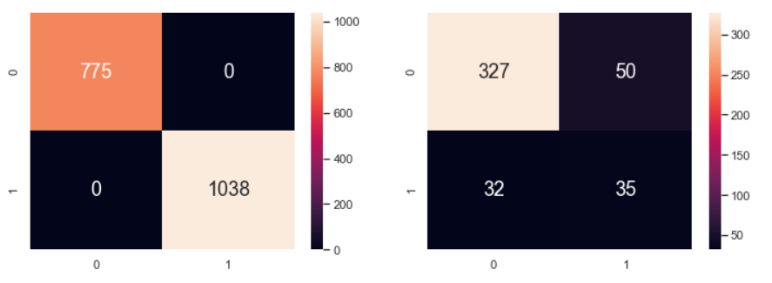
Extreme Gradient Boosting Classifier (XGB)
Extreme Gradient Boosting Classifier (XGB)
Accuracy Score: 76.22%

Slide 32
Extreme Gradient Boosting Classifier (XGB) - ROC curve & Precision Recall Curve
AUC : 0.8341
PR = 0.5

Slide 33
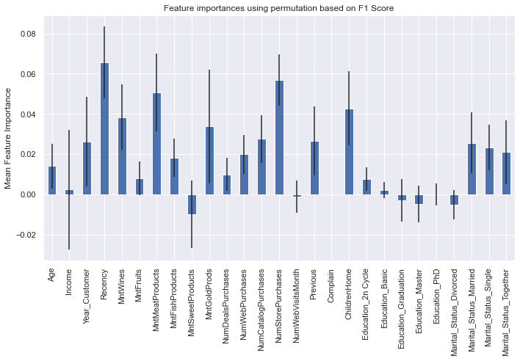
Extreme Gradient Boosting Classifier (XGB) - Features Importance
Top 4 Features
ChildrenHome
NumStorePurchases
Recency
MntMeatProducts

Slide 34
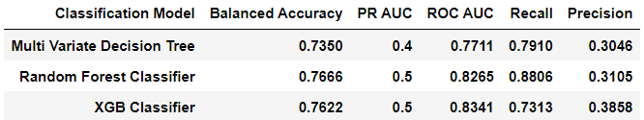
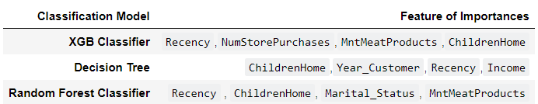
Summary for all Machine Learning Models
Recall=TP/(TP+FN)
Top 4 Features
ChildrenHome
Marital_Status
Recency
MntMeatProducts
Best Model
Random Forest Classifier

Slide 35

Conclusion
Best Model (Random Forest)
77% Balanced Accuracy
88% Recall
31% Precision
Campaign Targets
Family with children
Meat products
More recent customers

Slide 36

Conclusion
Best Model (Random Forest)
77% Balanced Accuracy
88% Recall
31% Precision
Marketing Campaign
Campaign Targets
Family with children
Meat products
More recent customers

Slide 37
Thank You! ☺

